Slide 1


Vasudev Karanth
February 11, 2024

Slide 2

Outline
Executive Summary
Introduction
Methodology
Results
Conclusion
Appendix

Slide 3
Executive Summary
SUMMARY OF METHODOLOGIES:
Step-1 | Data Collection-SpaceX Data collected using:
SpaceX API
Web-scarping from Wikipedia
Step -2 | Data Wrangling-with focus on:
Exploratory Data Analysis
Determining Training Labels
Step -3 | Exploratory Data Analysis-using:
SQL
Pandas and Matplotlib for visualization
Step -4 | Interactive visual analytics:
Launch Sites Locations Analysis with Folium
Interactive Dashboard with Plotly Dash
Step -5 | Machine Learning Prediction:
K-nearest neighbors
Decision Tree
Logistic Regression
Support Vector Machine

Slide 4
Executive Summary
SUMMARY OF ALL RESULTS:
Results of Exploratory Data Analysis:
SQL
Padas and Matplotlib
Results of Interactive Analytics using:
Folium:
Visualizing launch sites on Map
Visualizing the success/failed launches for each launch site on Map
Visualizing the distances between a launch site to its proximities
Plotly Dash:
Visualizing interactive dashboard showcasing a pie-chart and scatter plot of launch outcomes
Results of Predictive analysis
Best Hyperparameters
Best model
Confusion Matrix for the best model

Slide 5
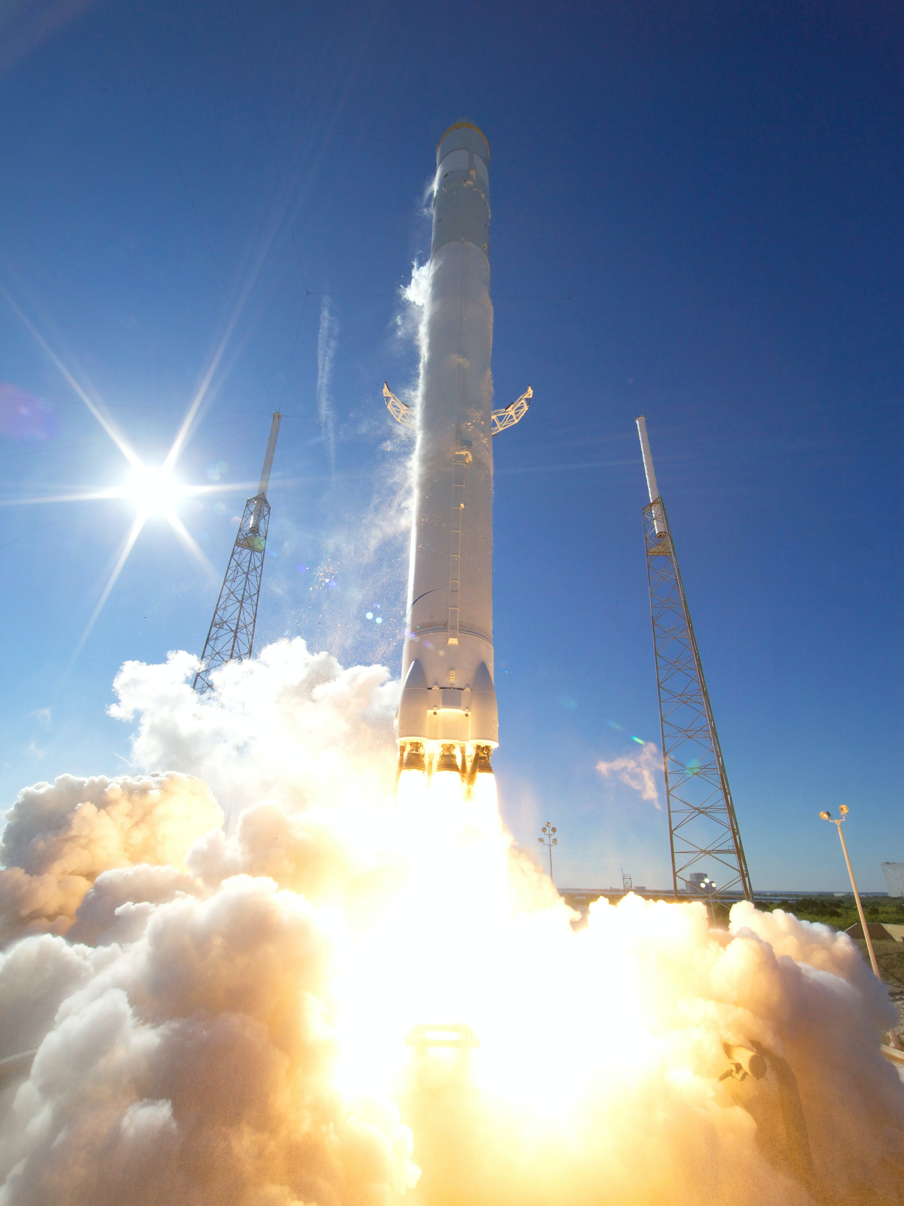
Introduction
Project background and context:
Background: Space X advertises Falcon 9 rocket launches on its website with a cost of 62 million dollars other providers cost upward of 165 million dollars each, much of the savings is because Space X can reuse the first stage. Therefore if we can determine if the first stage will land, we can determine the cost of a launch. This information can be used if an alternate company wants to bid against space X for a rocket launch.
Purpose: The Scope of this project is to analyze various sources of data available on Falcon 9 rocket launches and create a Machine Learning pipeline to determine if the First Stage will land successfully or not.

Slide 6
Introduction
Problems you want to find answers:
What factors determine the launch outcome?
Is there any relation amongst these factors that affect the success of a rocket landing?
What are the ideal conditions to ensure a successful landing of rocket?

Slide 7

Section 1

Slide 8
Methodology
Executive Summary
Data collection methodology:
The Data pertaining to the Falcon rocket launches was obtained using the following:
Space X website using the SpaceX API (i.e., https://api.spacexdata.com/v4/) and
Web scraping from Wikipedia page titled ‘List of Falcon 9 and Falcon Heavy launches’ (i.e., https://en.wikipedia.org/wiki/List_of_Falcon_9_and_Falcon_Heavy_launches)
Perform data wrangling:
Data collected from the above mentioned sources were converted into a data frame.
A new variable named ‘landing_class’ was created to represent the outcome with value ‘0’ for unsuccessful and ‘1’ for successful landings.
The function ‘get_dummies’ was used to apply one-hot encoding to the categorical variables in the data frame.

Slide 9
Methodology
Perform exploratory data analysis (EDA) using visualization and SQL
EDA was performed using Matplotlib visualization library and SQL.
The purpose of the exercise was to obtain valuable insights into the data for further analysis and model development.
Perform interactive visual analytics using Folium and Plotly Dash
Folium: Visualizing launch sites on Map. Visualizing the success/failed launches for each launch site on Map. Visualizing the distances between a launch site to its proximities. | Plotly Dash: Visualizing interactive dashboard showcasing a pie-chart and scatter plot of launch outcomes.

Slide 10
Methodology
Perform predictive analysis using classification models
The data was standardized using the ‘StandardScaler’ method of the sklearn pre-processing library.
Later, the data was split training and testing data.
Different classification models were fit and the best hyper parameter and the best model were evaluated.
Confusion matrix for each of the models were plot in the process.

Slide 11
Data Collection
Space X website using the SpaceX API (i.e., https://api.spacexdata.com/v4/) and
Web scraping from Wikipedia page titled ‘List of Falcon 9 and Falcon Heavy launches’ (i.e., https://en.wikipedia.org/wiki/List_of_Falcon_9_and_Falcon_Heavy_launches)
Sources of Data:
Space X API:
‘requests.get’ was used to call the API.
Next, the response content was decoded as a Json using ‘json()’ function call and turn it into a pandas dataframe using ‘json_normalize’ function.
From the data frame, the data was filtered keeping only those variables that are essential for the analysis.
The missing values in the dataset were identified and the mean values for the corresponding variable were calculated.
The missing values were replaced with the said mean values.
Web scraping:
Web scraping was further performed using ‘Beautiful Soup’ to extract Falcon 9 launch records HTML table from Wikipedia.
The table in the said result page was Parsed and converted it into a Pandas data frame for further analysis.

Slide 12
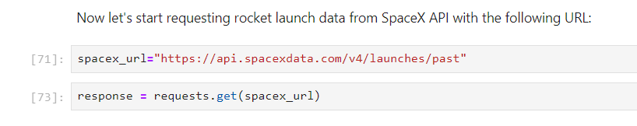
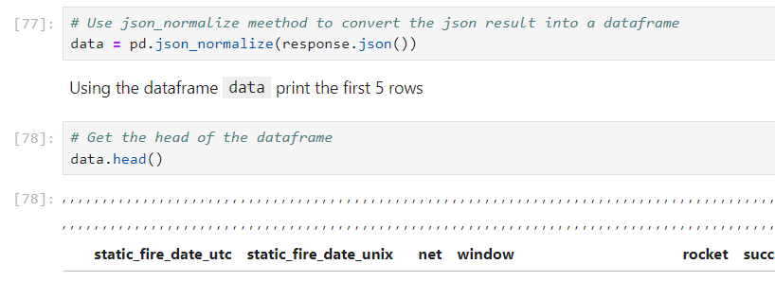
Data Collection – SpaceX API
The ‘requests’ library was imported to make HTTP requests.
The ‘requests.get() method was used to make the API calls and obtain the required data.
The response was decoded as a Json using ‘.json()’ method.
Later the data was converted into a Pandas data frame using ‘json_normalize()’ function.

Slide 13
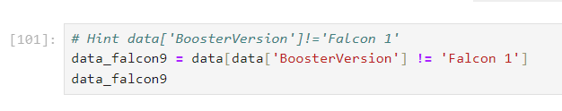
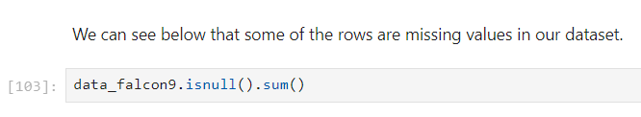
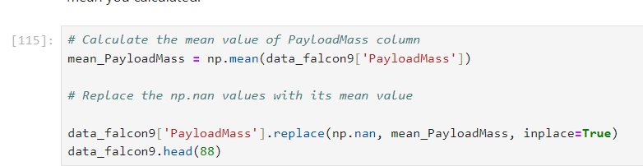
Data Collection – SpaceX API
The data was later cleaned to include only the required features, filtered the data to include only the ‘Falcon 9 launches’, performed basic data wrangling to identify and fill missing values
Github Link:
https://github.com/Vasudevkaranth/IBM_Datascience_Course_10_Capstone/blob/main/jupyter-labs-spacex-data-collection-api.ipynb

Slide 14
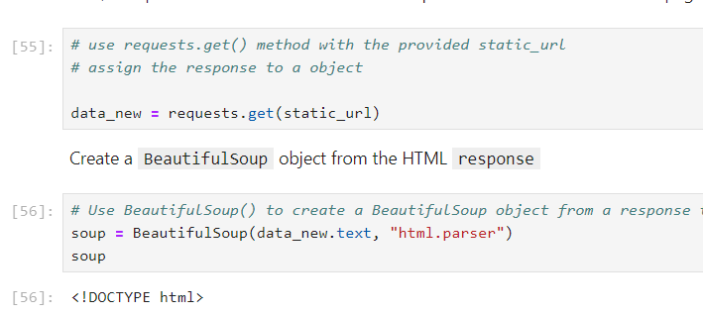
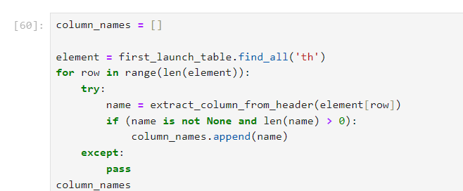
Data Collection - Scraping
Later web scraping was performed to collect Falcon 9 historical launch records from a Wikipedia page titled `List of Falcon 9 and Falcon Heavy launches`.
The ‘HTTP get()’ method was used to access the data, and a `BeautifulSoup` object was created from the HTML `response`.
The ‘<th>’ elements were iterated on the said response to identify the column names.
An empty dictionary was later created, with the column names so identified and later a pandas data frame was created with the column names.

Slide 15
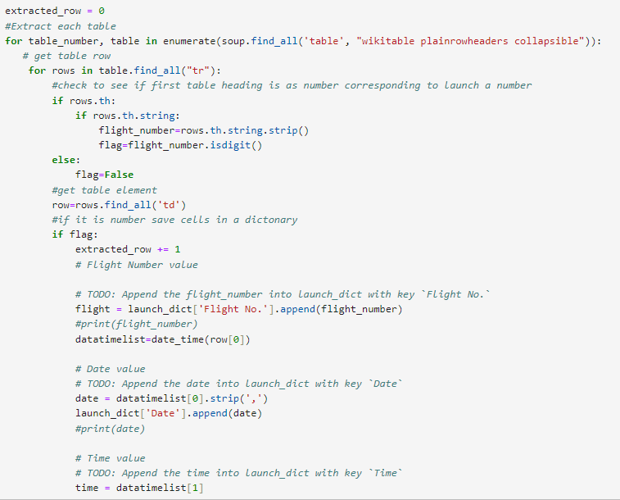
Data Collection - Scraping
Later, the html parsed through and the data frame with updated with the values thereon.
The result was later saved as a ‘CSV’ file.
Github Link:
https://github.com/Vasudevkaranth/IBM_Datascience_Course_10_Capstone/blob/main/jupyter-labs-webscraping.ipynb

Slide 16
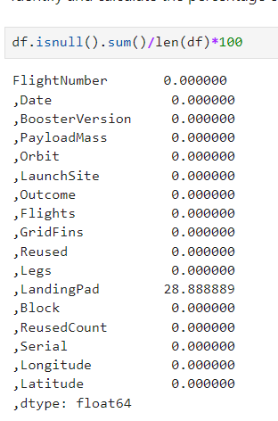
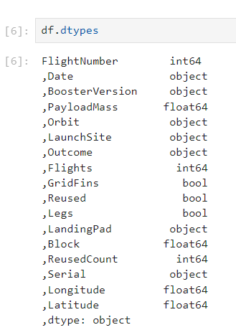
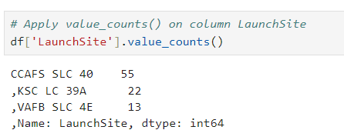
Data Wrangling
The data saved earlier in the CSV format was loaded on the jupyter notebooks for the purpose of data wrangling.
During the process,
Number of missing values were identified for each attribute.
The data type for each attribute was identified using the ‘.dtypes’ method.
Number of launches at each launch site were determined

Slide 17
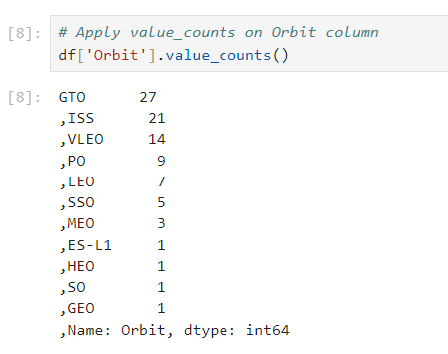
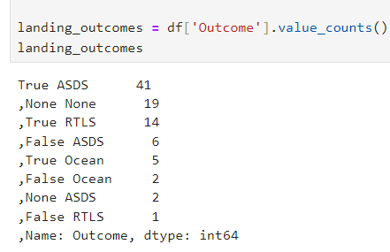

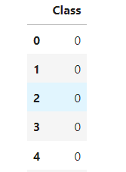
Data Wrangling
Number of launches to each orbits and number of occurrences were determined
Subsequently, the data was processed further by creating a variable ‘Class’ with value 0 representing unsuccessful landing and 1 representing successful landing
Github Link:
https://github.com/Vasudevkaranth/IBM_Datascience_Course_10_Capstone/blob/main/labs-jupyter-spacex-Data%20wrangling.ipynb

Slide 18
EDA with Data Visualization
The scope of EDA with visualization was to identify the variables that would affect the outcome.
‘Scatter Plot’ was used for the purpose of visualization as it was the most effective visualization tool to visualize the relationship between 2 variables.
Accordingly, the following plots were visualized for analysis:
Flight Number vs. Payload Mass
Flight Number vs. Launch Site
Payload Mass vs. Launch Site
Flight Number vs. Orbit
Payload vs. Orbit

Slide 19
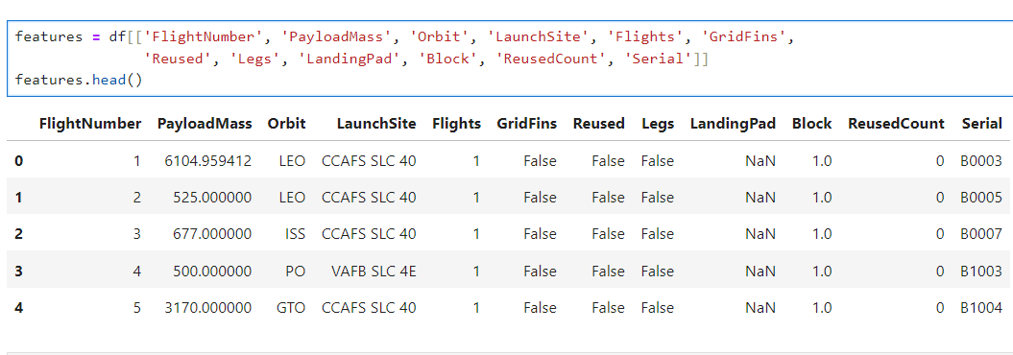
EDA with Data Visualization
Based on the analysis of scatter plots, a data frame referred to as ‘features’ was created.
This data frame contained those attributes that were identified for further analysis and prediction.

Slide 20
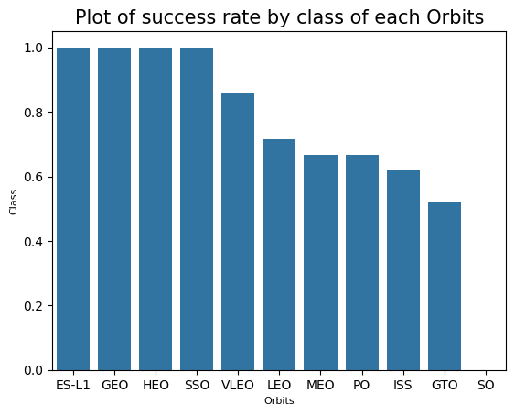
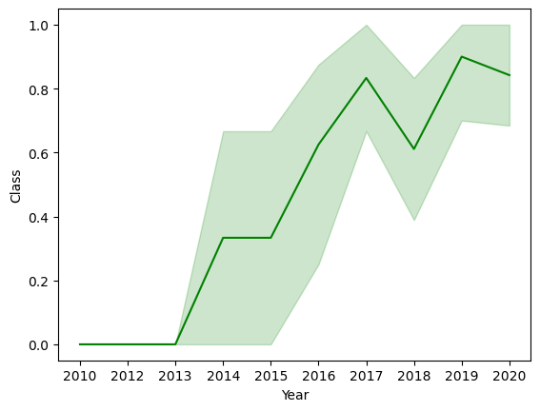
EDA with Data Visualization
A Bar chart depicting success rate for each orbits was created.
Also, a line chart for yearly success rates since 2013 was depicted to visualize yearly trend as follows
Github Link:
https://github.com/Vasudevkaranth/IBM_Datascience_Course_10_Capstone/blob/main/jupyter-labs-eda-dataviz.ipynb.jupyterlite.ipynb

Slide 21
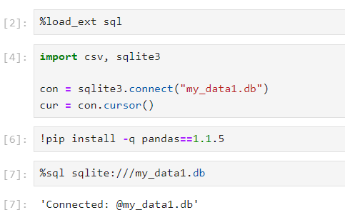
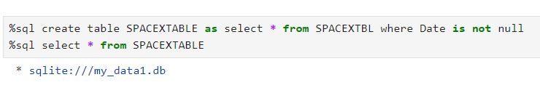
EDA with SQL
To query the SpaceX dataset, ‘SQLAlchemy’ a SQL toolkit for the Python programming language was used.
Using the SQL extension, connection to the sqlite database was established as follows:
Later, a new table ‘SPACEXTABLE’ was created after filtering the data to remove the rows with blank values using the following SQL query:

Slide 22
EDA with SQL
Later, the following SQL queries were executed for the purpose of analysis of data. The following were found out in the process:
Names of unique launch sites in the space mission.
Total payload mass carried by boosters launched by NASA (CRS).
Average payload mass carried by booster version F9 v1.1.
Date when the first successful landing outcome in ground pad was achieved.
The names of the boosters which have success in drone ship and have payload mass greater than 4000 but less than 6000.
The total number of successful and failure mission outcomes.
Github Link:
https://github.com/Vasudevkaranth/IBM_Datascience_Course_10_Capstone/blob/main/jupyter-labs-eda-sql-coursera_sqllite.ipynb

Slide 23
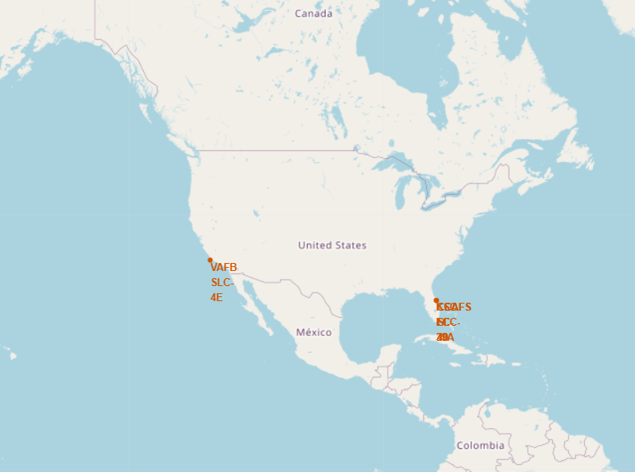
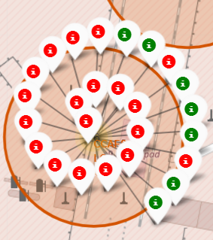
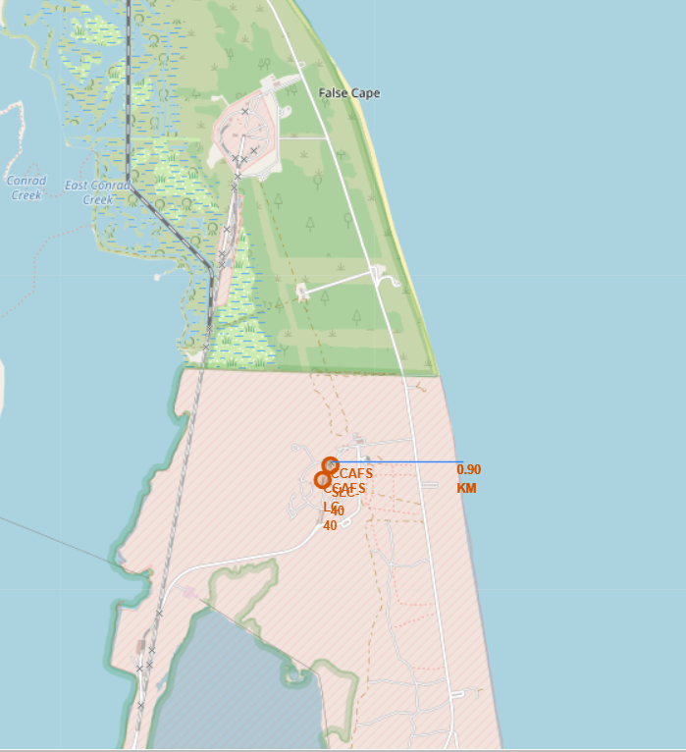
Build an Interactive Map with Folium
The objects of building an interactive Map with folium were as follows:
Marking the launch Sites on the Map with markers, circles.
Marking the success/failed launches for each site on the map with the help of color labelled marker clusters.
Calculating the distance between a launch site to its proximities such as city, highway, railway, airport using lines

Slide 24
Build an Interactive Map with Folium
The launch sites were marked on a map to determine its’ geographic location.
Since each launch site had multiple launches, marker cluster (i.e., ‘MarkerCluster()’) was used to simplify the visualization.
Using the values in attribute ‘Class’ as the base, a new attribute ‘marker_color’ was created and later this was assigned to the marker cluster. Red color was assigned to unsuccessful landings and green color was assigned to the successful landings.
Later, `MousePosition` method was used on the map to get the coordinates for a mouse over a point on the map;
With the help of coordinates, distance to the proximities such as distance to coastline, cities, highways etc., were calculated and relevant questions were answered.
Github Link:
https://github.com/Vasudevkaranth/IBM_Datascience_Course_10_Capstone/blob/main/lab_jupyter_launch_site_location.jupyterlite.ipynb

Slide 25
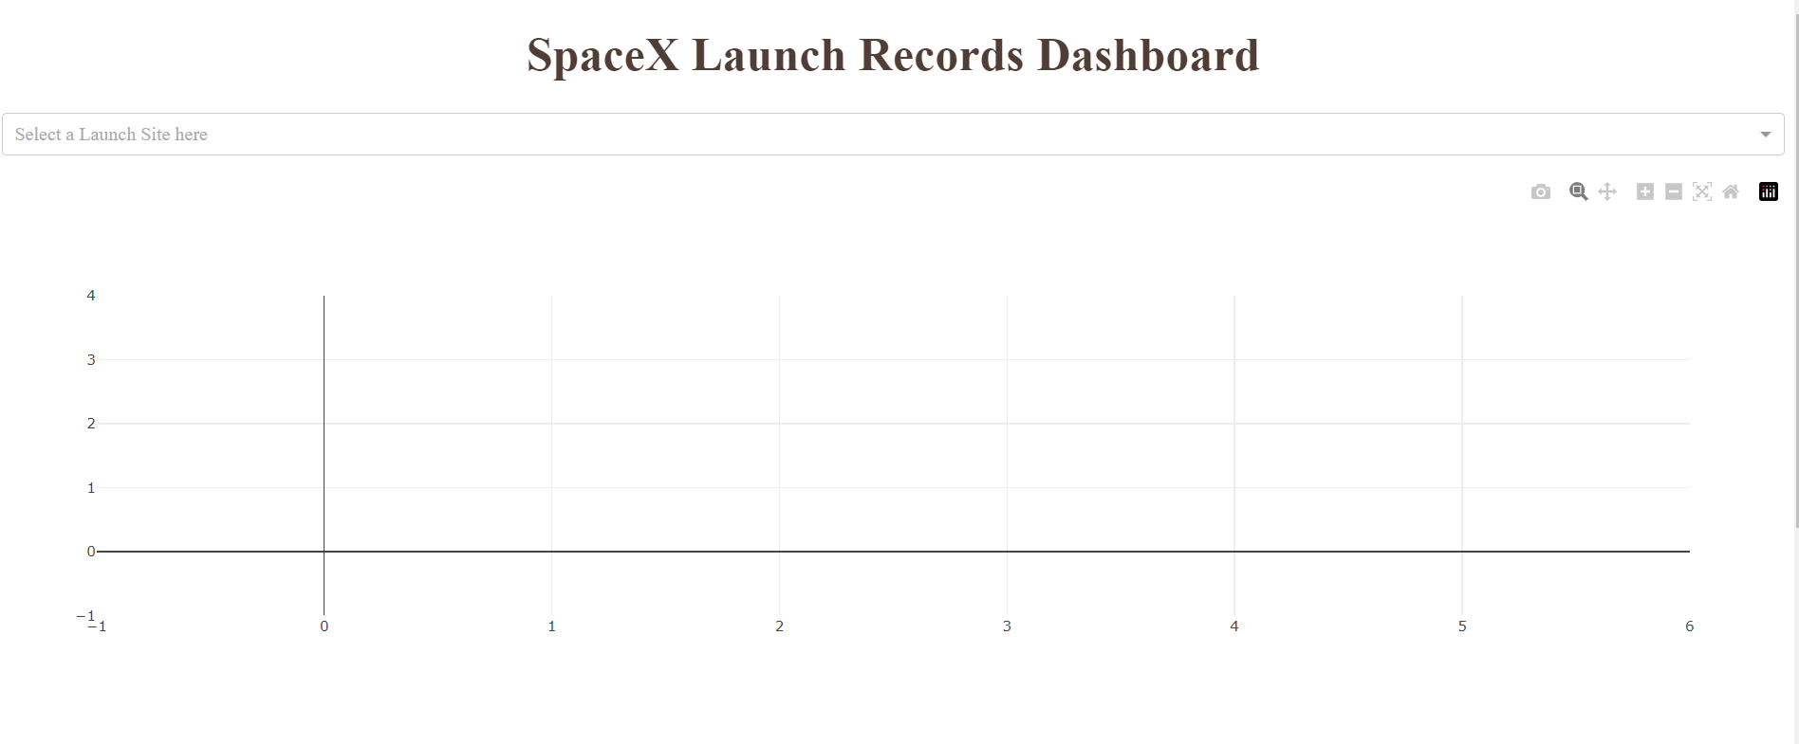
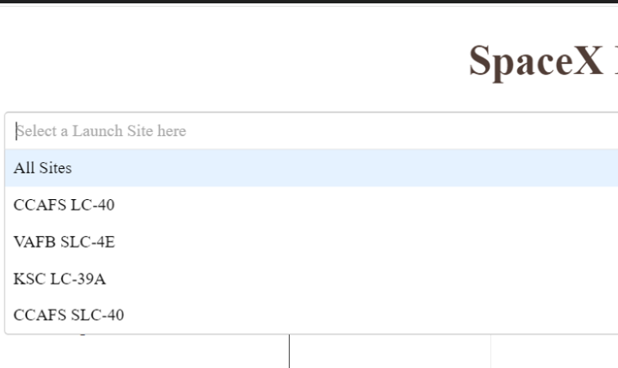
Build a Dashboard with Plotly Dash
An interactive Dashboard was created using ‘Plotly Dash’.
Skeleton of the dash application is as follows:
A drop-down was created to select the launch site for the graphs.
User has the choice to select all or any of the launch sites from the drop-down

Slide 26
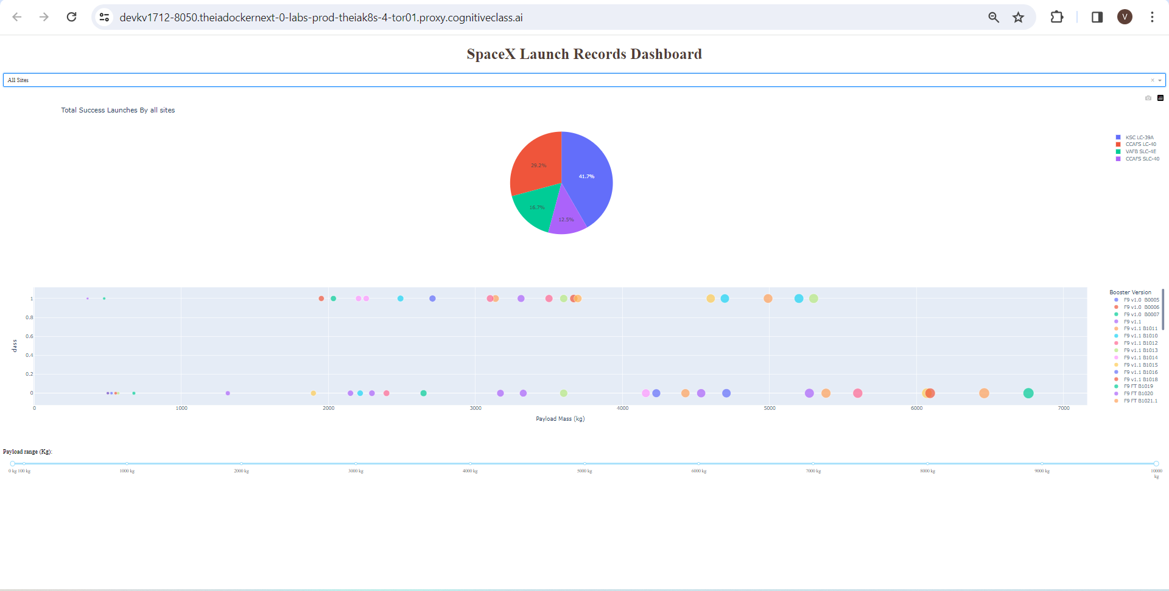
Build a Dashboard with Plotly Dash
A slider was further also added to fine tune the results, based on the payload mass with range from 0 to 10,000 Kgs,
Github Link:
https://github.com/Vasudevkaranth/IBM_Datascience_Course_10_Capstone/blob/main/spacex_dash_app.py

Slide 27
Build a Dashboard with Plotly Dash
The ‘app.callback’ operator to perform interactive dash call backs, which would take ‘launch site’ from the dropdown and payload mass from the slider as input and output the charts mentioned below:
A ‘pie-chart’ visualizing the successful launches based on the launch site selected from the drop down.
A Scatter Plot visualizing the outcomes, based on the selected payload range.

Slide 28
Predictive Analysis (Classification)
The purpose of the analysis was to determine if a rocket launch by SpaceX would be successful or not depending on factors such as payload mass, number of flights etc.
As the outcomes of analysis would be to determine if a landing was ‘Successful’ or ‘Unsuccessful’, the classification models were used to perform the analysis.
The following classification models were used to perform the analysis:
Decision Trees
SVM
Logistic Regression and
KNN

Slide 29
Predictive Analysis (Classification)
A pipeline was created to predict the landing outcome in the following manner:
Standardized the data using the preprocessing.StandardScaler() function of sklearn
The data was split into training and testing data using the ‘train_test_split’ function (test size was taken as 0.2)
Respective machine learning model classification models were fit on the train data and then tested on the test data to determine the accuracy
GridSearch CV object was used to determine the best hyperparameter for the selected model
Accuracy score was used as the metric for the model and the feature engineering and algorithm tuning was used to tune the model further

Slide 30

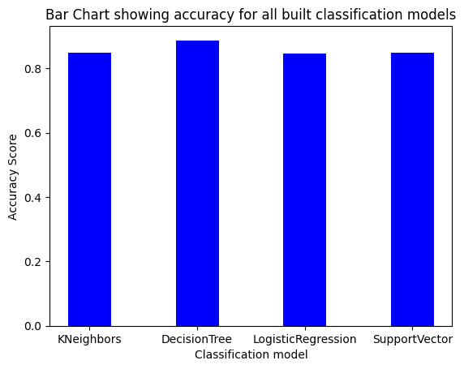
Predictive Analysis (Classification)
The best model for the launch data was Decision Tree, with a classification score of 0.8875
The confusion matrix of the said model is given in the above diagram
Github Link:
https://github.com/Vasudevkaranth/IBM_Datascience_Course_10_Capstone/blob/main/SpaceX_Machine_Learning_Prediction_Part_5.jupyterlite.ipynb

Slide 31
Results: Slides need updating
Exploratory data analysis results:
EDA with visualization results: Slides 33 to 38
EDA with SQL results: Slides 39 to 49
Interactive analytics demo in screenshots:
Folium Map: Slides 51 to 58
Plotly: Slides 60 to 63
Predictive analysis results:
Slides 65 and 66

Slide 32

Section 2

Slide 33
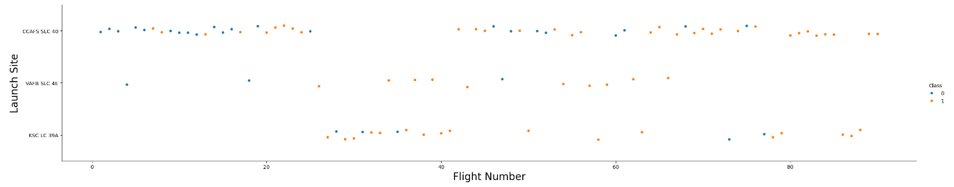
Flight Number vs. Launch Site
Analysis:
Larger the number of flights at a launch site, greater is the success rate.

Slide 34
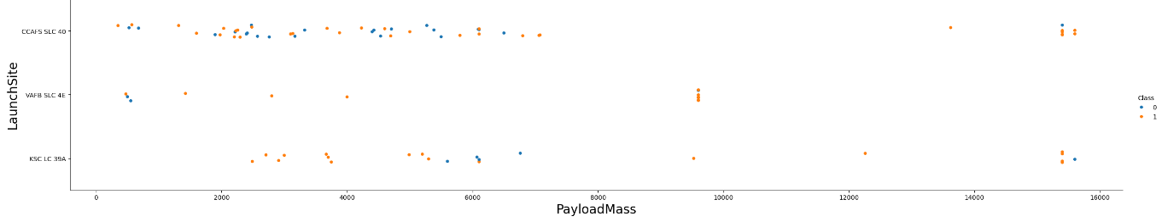
Payload vs. Launch Site
Analysis:
Larger the payload, greater is the success rate.
With a few exceptions, most of the launches with payload mass exceeding 10,000 Kg have been successful.

Slide 35
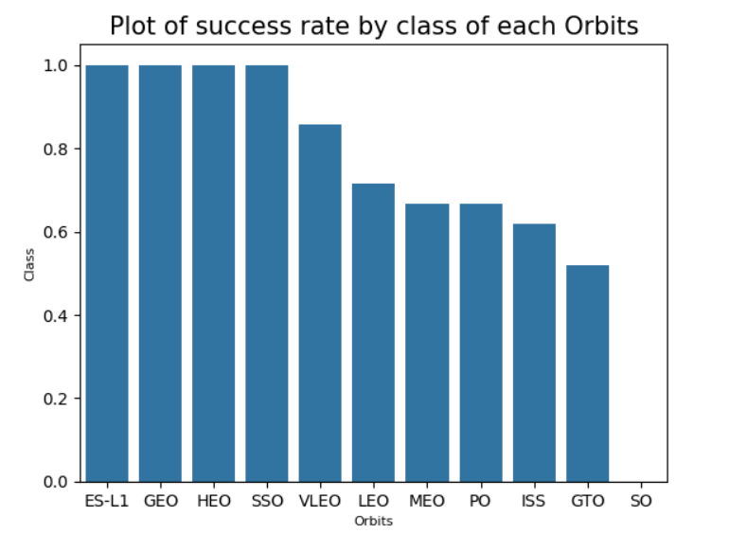
Success Rate vs. Orbit Type
Analysis:
Launches to ES-L1, GEO, HEO and SSO orbits had the most success rates.
Launches to VLEO, LEO, MEO and PO orbits had comparatively lower success rates.
Launches to ISS, GTO and SO had the least success rates.

Slide 36
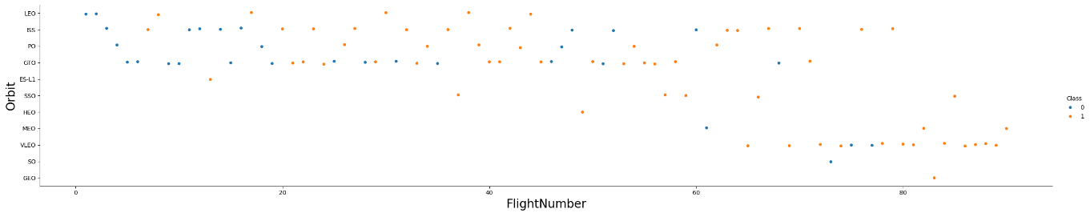
Flight Number vs. Orbit Type
Analysis:
from the above plot, it can be concluded that the relationship between the flight number and orbit is ambiguous.
In case of LEO orbit, it appears that the success rate depends on the number of flights. However, the same cannot be said for the other orbits such as the GTO orbit.
Therefore, it is not easy to distinguish the relationship between the flight numbers and orbit for other orbits.

Slide 37
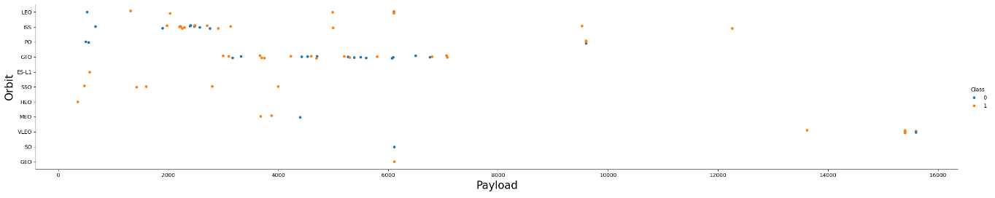
Payload vs. Orbit Type
Analysis:
the LEO, ISS and PO orbits have more successful landings for heavy payloads.
However, similar pattern cannot be determined for other orbits on account of the following reasons:
There are both observations (i.e., successful and unsuccessful) for each class of payloads in certain orbits such as GTO, VLEO etc.
Some orbits such as SSO, do not have observations beyond certain payload.

Slide 38
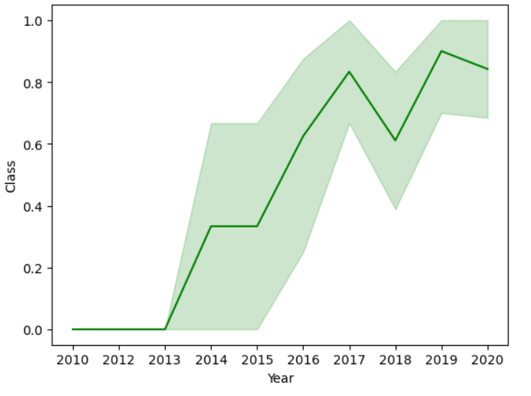
Launch Success Yearly Trend
From the Line plot, an upward trend is observed in the success rates till the year 2020, with a downward movement in the year 2018 (i.e., success rates have been improving since 2013.
Year 2018 may require further analysis to determine the reasons for the downward movement

Slide 39
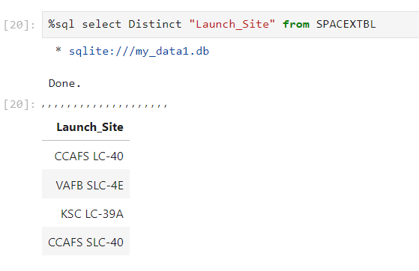
All Launch Site Names
At the beginning, a SQL query was executed to identify the names of launch sites.
The ‘SELECT DISTINCT’ statement was used to get the desired result.
The query yielded the following four launch site names:
CCAFS LC-40
VAFB SLC-4E
KSC LC-39A
CCAFS SLC-40

Slide 40
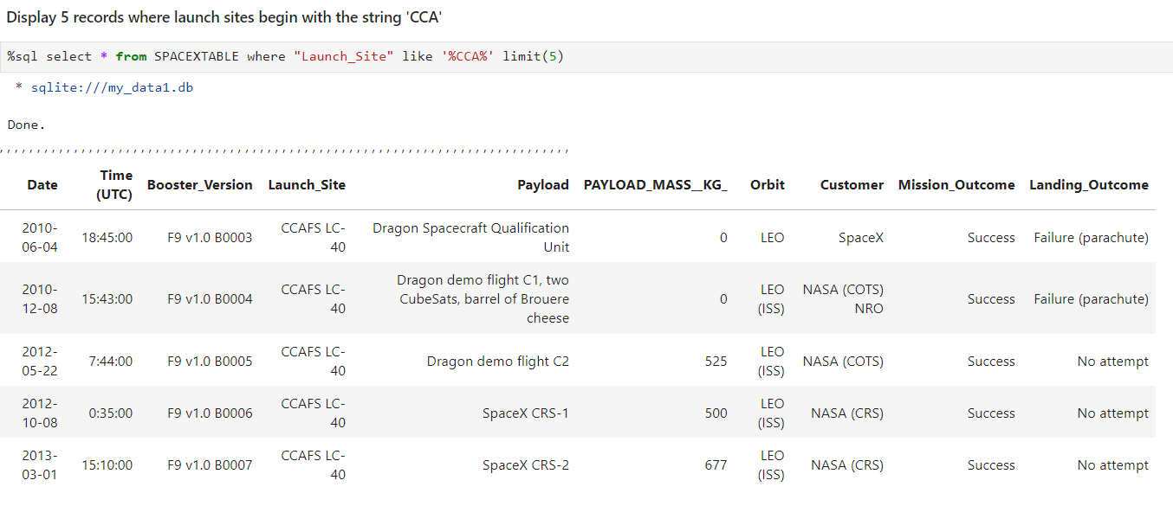
Launch Site Names Begin with 'CCA'
To get the 5 records where launch sites begin with `CCA`, the following SQL query was used.
The ‘LIKE’ operator was used in the ‘WHERE’ clause to search for a specified pattern (i.e., launch sites beginning with name ‘CCA’) to get the desired results.

Slide 41
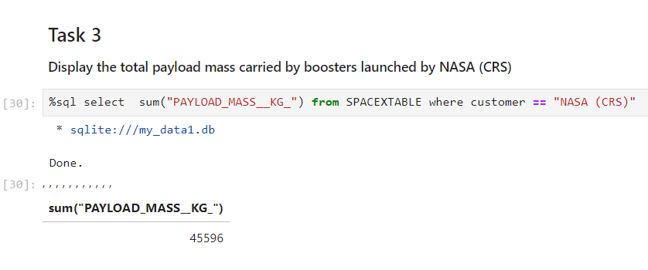
Total Payload Mass
To calculate the total payload carried by boosters from NASA, the query mentioned below was used.
The ‘SUM()’ function was used to calculate the total payload mass.
The ‘WHERE’ clause specified the specific site (i.e., NASA (CRS)) as criteria as to filter the results.
The query yielded the result of 45596.

Slide 42
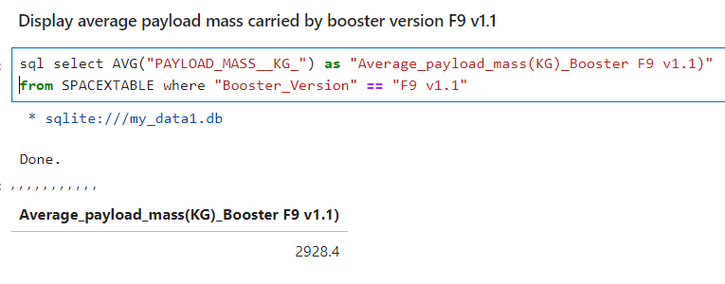
Average Payload Mass by F9 v1.1
To calculate the average payload mass by carried by booster version F9 v1.1, the following query was used.
The ‘AVG()’ function was used to find the average payload mass.
The ‘WHERE’ clause specified the specific booster (i.e., F9 v1.1) as criteria to filter the results.
The query yielded the result 2928.4.
The result was saved as ‘Average_payload_mass(KG)_Booster F9 v1.1’ for easy reference.

Slide 43
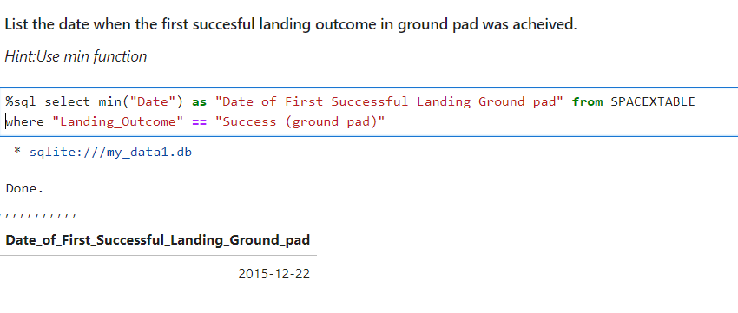
First Successful Ground Landing Date
To calculate the first successful ground launch date, the following query was used.
The MIN() function was used to find the earliest date for the query.
The ‘WHERE’ clause specified the specific outcome (i.e., ‘Success (ground pad)” as criteria as to filter the results
The query yielded the date 2015-12-22 as the result..
The result was saved as ‘Date_of_First_Successful_Landing_Ground_Pad for easy reference

Slide 44
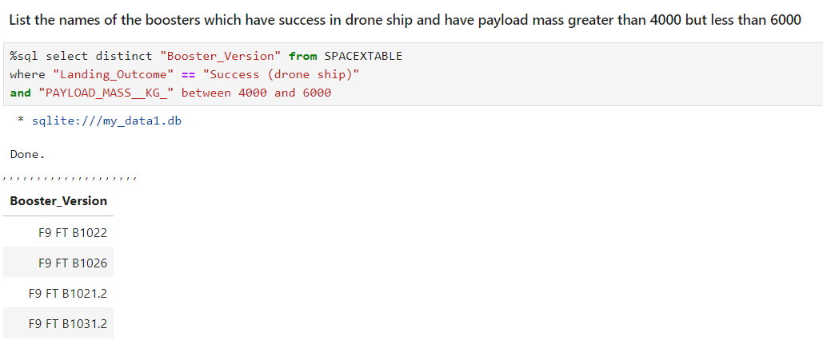
Successful Drone Ship Landing with Payload between 4000 and 6000
To find the names of boosters which have successfully landed on drone ship and had payload mass greater than 4000 but less than 6000, following query was used.
The ‘SELECT DISTINCT’ statement was used on the attribute ‘Booster Version’ to identify unique booster Versions.
The ‘WHERE’ clause specified the specific outcome (i.e., ‘Success (drone ship)’) and payload range between 4000 and 6000 to get the desired result.

Slide 45
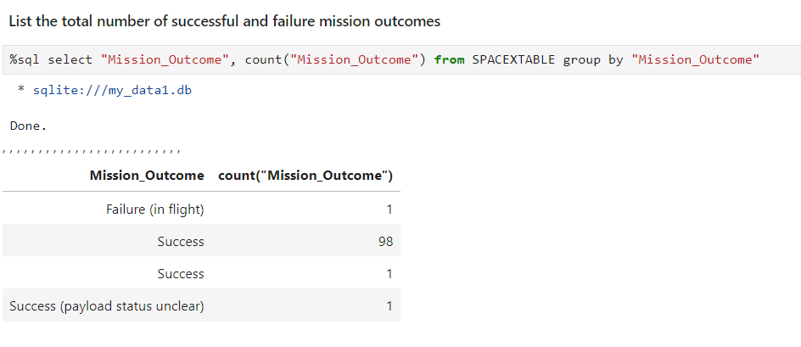
Total Number of Successful and Failure Mission Outcomes
To calculate the total number of successful and failure mission outcomes, the following query was used.
The COUNT() function was used on the ‘Mission_Outcome’ attribute to find number of results in each category.
The ‘GROUP BY’ function was used to group all the observations based on criteria specified (i.e., mission outcomes).

Slide 46
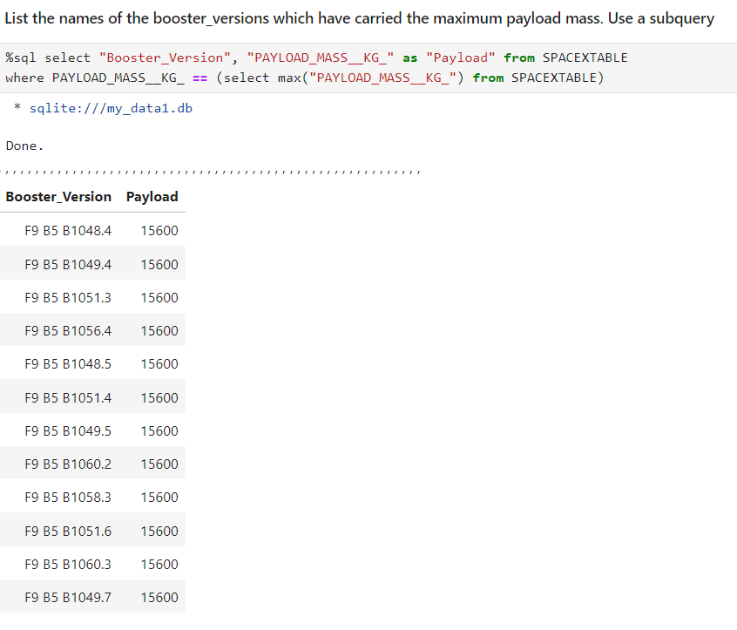
Boosters Carried Maximum Payload
To find the names of the boosters that have carried the maximum payload mass, the following query was used.
The ‘Booster_Version’ and ‘Payload_Mass_(KG)’ attributes were chosen.
As required, a sub-query was used to determine the maximum payload mass in the ‘Where’ clause.
The ‘MAX()’ function was applied on the pay load attribute to determine the maximum payload.
The query yielded a result containing the booster versions carrying payload of 15600 Kgs, being the maximum payload.

Slide 47
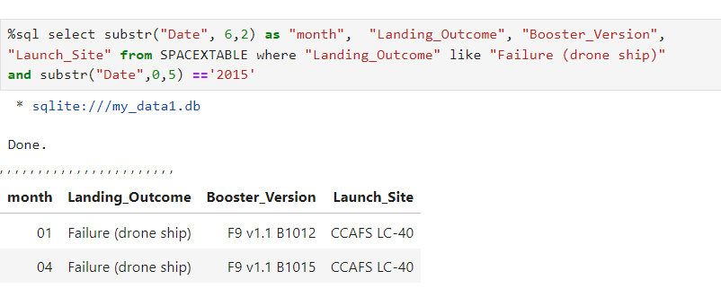
2015 Launch Records
To find the List of failed landing_outcomes in drone ship, their booster versions, and launch site names for the year 2015, the following query was used.
Since the SQLite did not support the month names. Therefore, ‘SUBSTR()’ function was used to get the month and date.
The ‘WHERE’ clause was used as to specify the specific criteria for querying the results

Slide 48
Rank Landing Outcomes Between 2010-06-04 and 2017-03-20
To find the count of landing outcomes (such as Failure (drone ship) or Success (ground pad)) between the date 2010-06-04 and 2017-03-20, in descending order, the query in the subsequent slide was used.
The ‘COUNT()’ function was used to get the count of distinct outcomes.
The ‘WHERE’ clause was used as to specify the date range for querying the results.
The ‘GROUPBY()’ function was used to group the outcomes.
The COUNT() DESC was used to filter the data in the descending order.

Slide 49
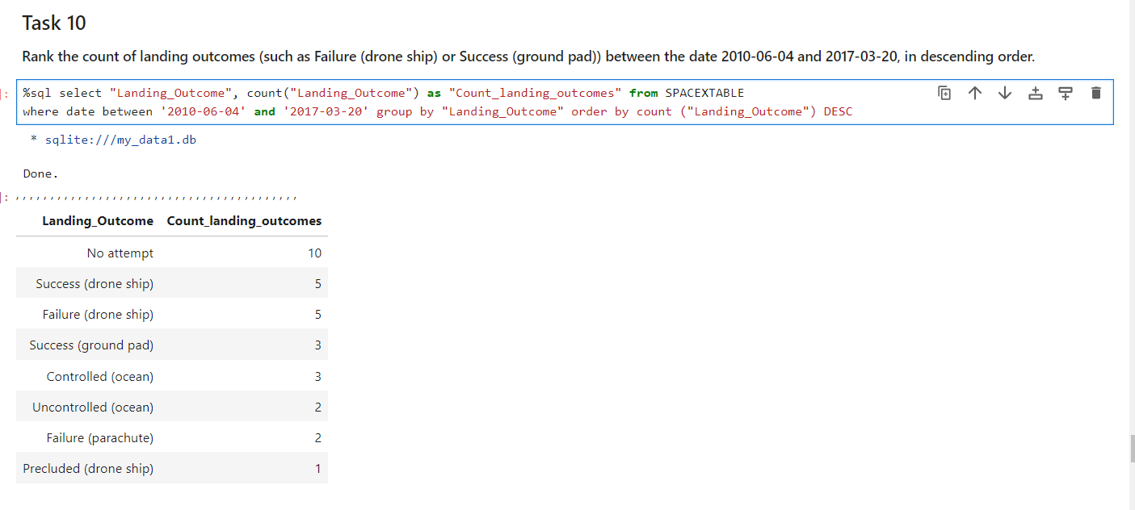
Rank Landing Outcomes Between 2010-06-04 and 2017-03-20

Slide 50

Section 3

Slide 51
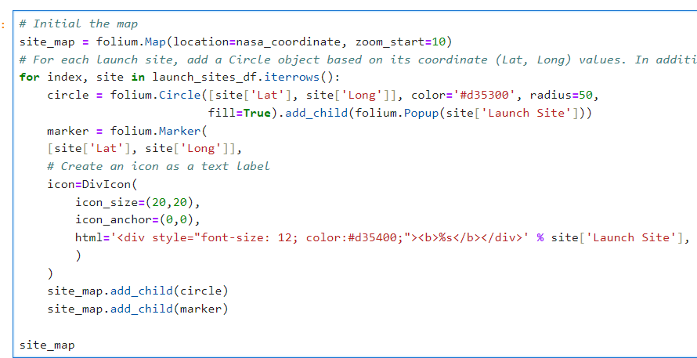
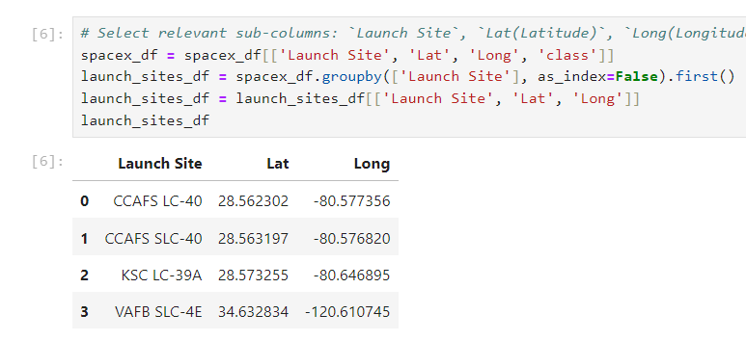
Locating the Space X launch centers on a Folium Map
Folium map was used to do the following:
Locate the launch sites on a map using site's latitude and longitude coordinates;
A circle was added to each launch site using the `folium.Circle` object and marked using the `folium.Marker`;
Add.child() function was used to add these launch sites on the global map;

Slide 52
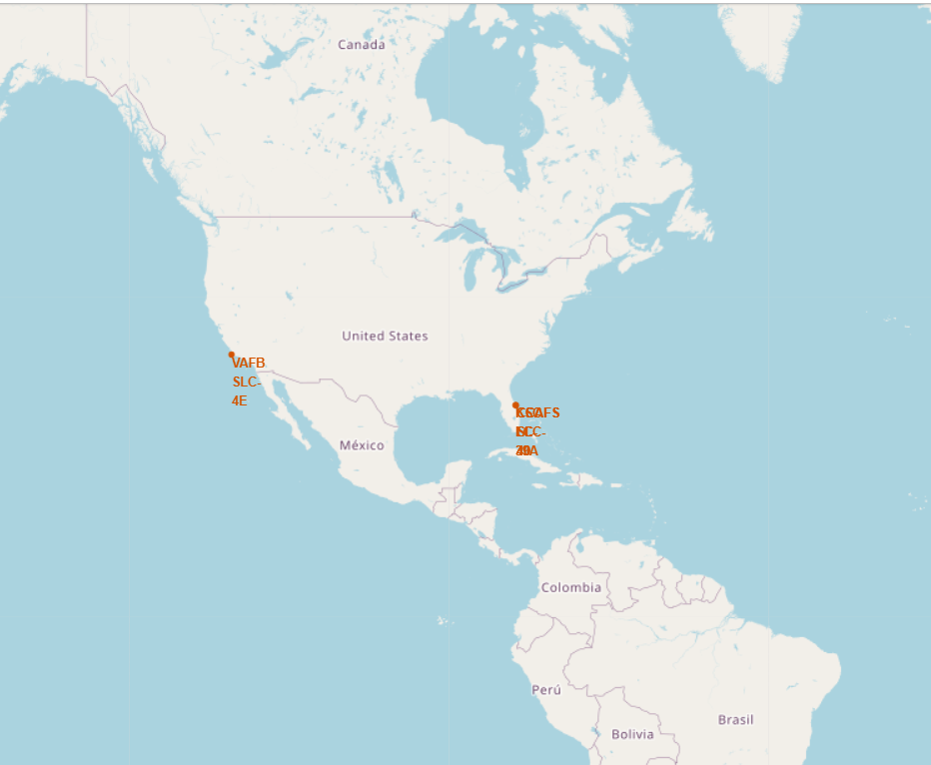
Locating the Space X launch centers on a Folium Map

Slide 53
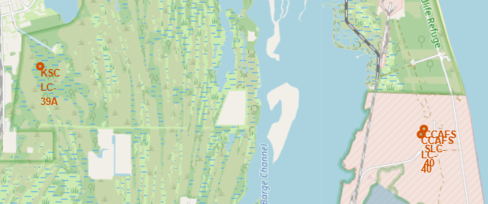
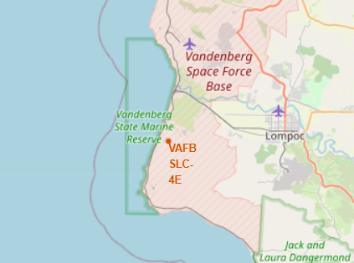
Locating the Space X launch centers on a Folium Map
Launch Sites zoomed in
Analysis:
It is observed from the folium map that each of the launch site are located in the United States of America and in the proximity to the coast.
The CCAFS LC-40, CCAFS SLC-40 and KSC LC-39A launch stations are located near the west coast in Florida.
The VAFB SLC-4E launch station is on the east coast in California.

Slide 54
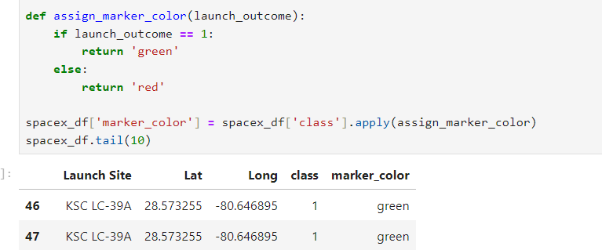
Color-labeled launch outcomes on the map
The folium map was further enhanced by adding the color-labeled launch outcomes on the map
At first, colors were assigned to identify if a landing was ‘successful’ or not ‘successful’ using the function in the slide.
Red color was assigned to unsuccessful and Green color was assigned to successful landing.
Later, MarkerCluster() object was added to the folium map to specify the outcomes to the landing outcomes at a landing site.
The exercise enabled to identify which launch sites have relatively high success rates.

Slide 55
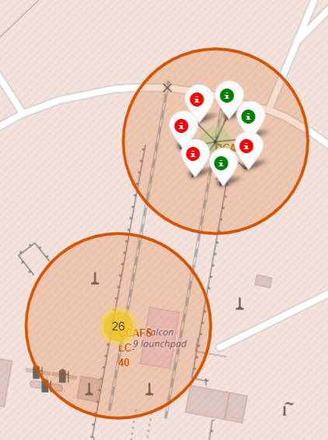


Color-labeled launch outcomes on the map
Results of Launch Sites in Florida
CCAFS SLC-40
CCAFS LC-40
KSC LC-39A

Slide 56

Color-labeled launch outcomes on the map
Launch Site in California
VAFB SLC-4E

Slide 57
Proximities such as railway, highway, coastline
Selected Launch Site: KSC LC-39A (Reason: Most successful launch site as per the data used).
Screenshots: enclosed in the subsequent slide.
Sl. No. | Particulars | Distance (KM) | Reference taken | Analysis
1 | Are launch sites in close proximity to coastline? | 7.59 | West Coast | Yes, the Launch site is fairly in close proximity to the coastline
2 | Do launch sites keep certain distance away from cities? | 71.67 | Orlando | Yes, the launch sites keep certain distance away from the cities.
3 | Are launch sites in close proximity to railways? | 21.90 | Florida East Coast Railways, Cocoa | No, the launch sites are not in close proximity to the railways.
4 | Are launch sites in close proximity to highways? | 20.20 | Cheney Highway | No, the launch sites are not in close proximity to the highways.
5 | Are launch sites in close proximity to Airport? | 16.31 | Space coast regional airport | No, the launch sites are not in close proximity to the airports.

Slide 58


Proximities such as railway, highway, coastline
Distance: Coast Line
Distance: Orlando city

Slide 59



Proximities such as railway, highway, coastline
Distance: Cheney Highway
Distance: Space coast regional airport
Distance: Florida East Coast Railways, Cocoa

Slide 60

Section 4

Slide 61

Pie-Chart: Launch Success for all sites
It can be concluded that KSC LC 39A launch site had the most successful launches of all the sites (i.e., 41.7%).
KSC LC 39A (success rate: 41.7%) and CCAFS LC-40 (success rate: 29.2%) launch sites contribute to the majority of the successful launches.

Slide 62


Pie Chart: Launch Site with highest launch success
KSC LC 39A launch site had the most successful launches of all the sites.
76.9% of the total launches from this site were successful, while 23.1% were unsuccessful
The Scatter plot below shows that most of the success launches carried lighter payloads

Slide 63

Scatter Plot: Payload vs. Launch Outcome scatter plot for all sites
Payload Mass Range(KG): 0 to 5000 KG
Analysis:
From the above scatter plot, it is observed that for loads up to 5000 Kgs, the success and failure rates are almost similar.
Booster version F9 v1.1 B1014 had the most successful launches for payloads beyond 4000 Kgs.
Booster version F9 FT B1021.1 had the most unsuccessful launches in the range.

Slide 64

Scatter Plot: Payload vs. Launch Outcome scatter plot for all sites
Payload Mass Range(KG): 5000 to 10000 KG
Analysis:
From the above scatter plot, it is observed that for loads exceeding 5000 Kgs, the success rates are lower.
Booster version F9 B4 B1041.1 had the most successful launch for payloads beyond 9000 Kgs.
Booster version F9 B4 B1041.2 had the most unsuccessful launch for payloads beyond 9000 Kgs.

Slide 65

Section 5

Slide 66
Classification Accuracy
The classification models had an accuracy score of at least 0.8
The best model for tjhe launch data was Decision Tree, with a classification score of 0.8875

Slide 67
Confusion Matrix
The best model for the launch data was Decision Tree, with a classification score of 0.8875
However, there was an issue with the false positives.
It is observed that majority of unsuccessful landings classified as positive.

Slide 68
Conclusions
Number of Flights:
Larger the number of flights at a launch site, greater was the success rate.
Payload Mass:
Larger the rocket payload, greater is the success rate.
Orbits:
Launches to ES-L1, GEO, HEO and SSO orbits had the most success rates.
With a few exceptions, most of the launches with payload exceeding 10,000 have been successful.

Slide 69
Conclusions
Launch year:
An upward trend is observed in the success rates till the year 2020, with a downward movement in the year 2018
Launch site:
KSC LC 39A launch site had the most successful launches of all the sites
Launch Sites share a few characteristics, such as proximity to the coastal line etc.,
Classification Model:
Upon evaluation of the data with different classification models, decision tree classified turned out to be the best machine learning classification model

Slide 70
Appendix
Github Link to the repository: https://github.com/Vasudevkaranth/IBM_Datascience_Course_10_Capstone.git
Links of data used:
SpaceX API (i.e., https://api.spacexdata.com/v4/) and
https://en.wikipedia.org/wiki/List_of_Falcon_9_and_Falcon_Heavy_launches
Photo used:
Slide 5: Photo by SpaceX: https://www.pexels.com/photo/rocket-launch-space-discovery-23795/

Slide 71


